Slide 1
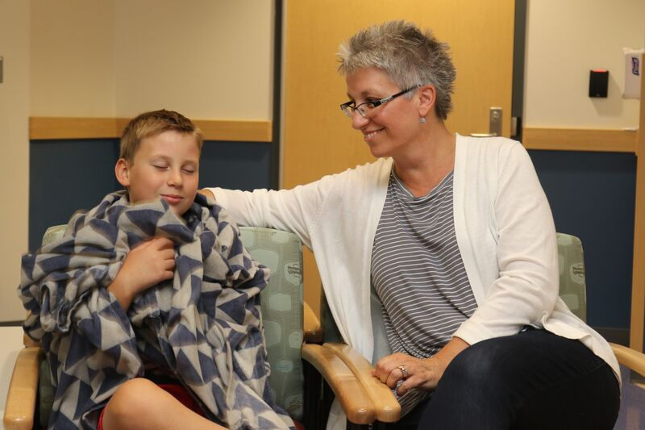
Here we go – to Sedation!
Kalyani Raghavan, MBBS, MD, DCH, FAAP & Jennifer Twachtman-Bassett, MS, CCC-SLP
Developed with a grant from Autism Speaks

Slide 2

I am going to Connecticut Children’s Medical Center for a special test.
I have to go to Sedation so that I can be asleep for my test.
I can bring my blanket and a special toy with me.

Slide 3

We will leave our car with the valet or in the parking garage.

Slide 4
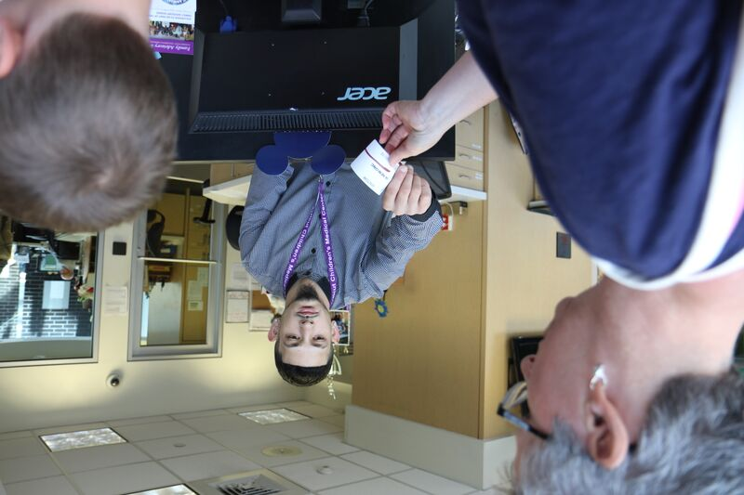
First we will go to the front desk. We will get stickers with our names to put on our clothes.

Slide 5
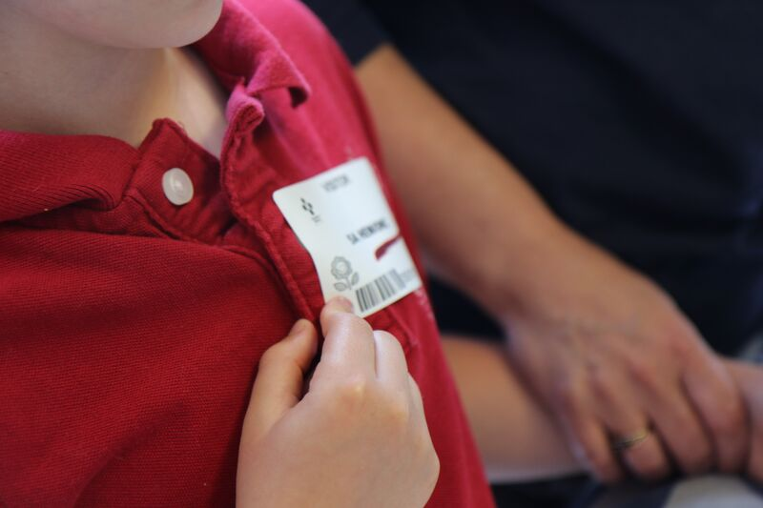
I will put the sticker on my shirt.
My Mom will get a sticker too!

Slide 6
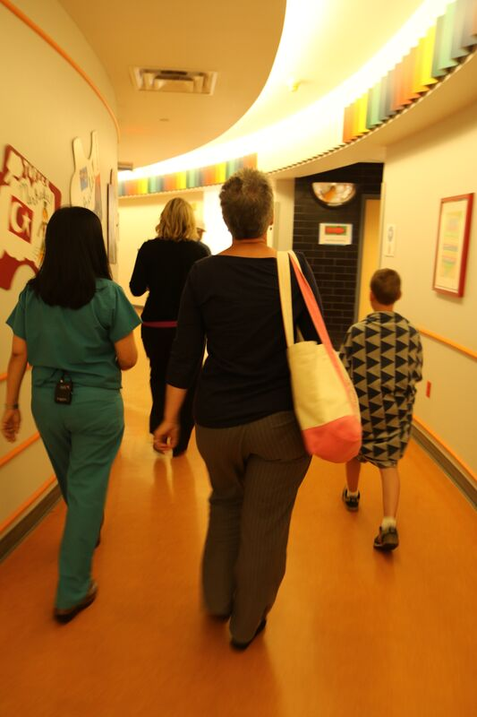
Then we will walk down the hallway to Sedation.

Slide 7
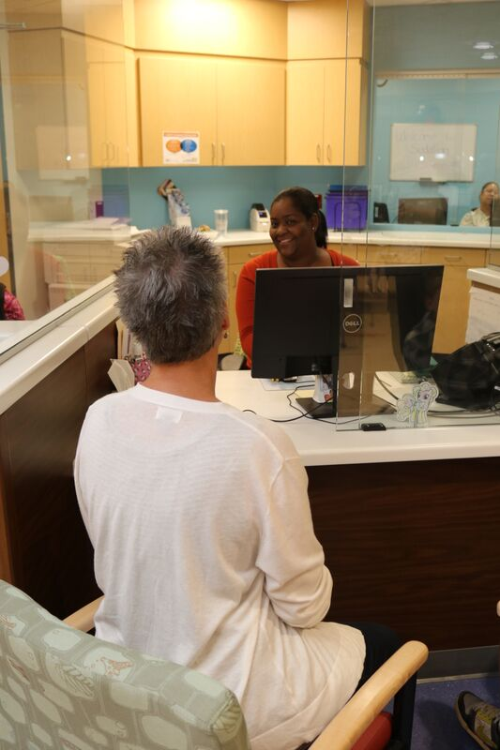
We are at Sedation! We will go to the check in window.
My Mom will tell the receptionist that I am ready for the test.

Slide 8
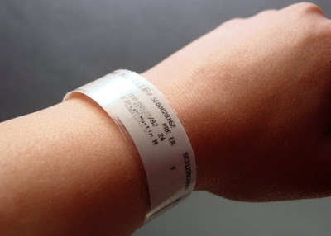
She will give me a bracelet to put on my wrist.
The bracelet will have my name!

Slide 9

I can watch TV or play with some toys while I am waiting

Slide 10
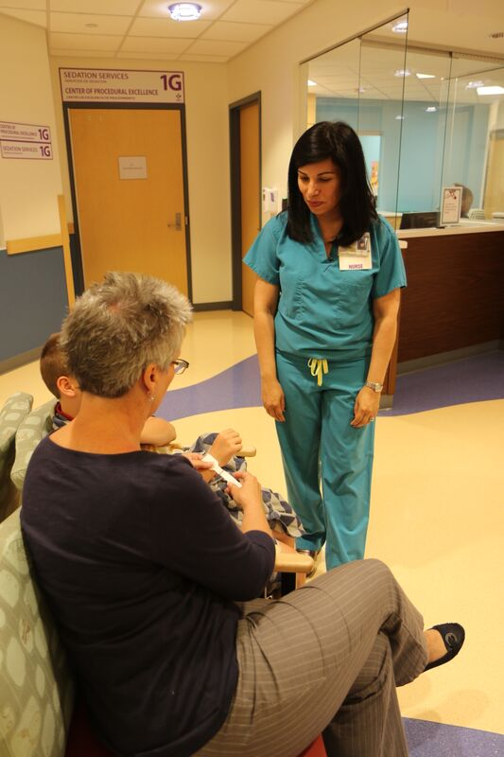
Here is the nurse.
She will take us inside.

Slide 11
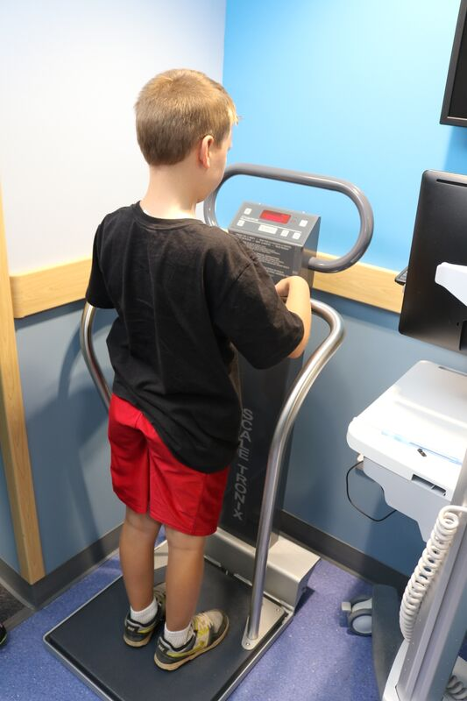
First I will stand on the scale to check my weight.

Slide 12
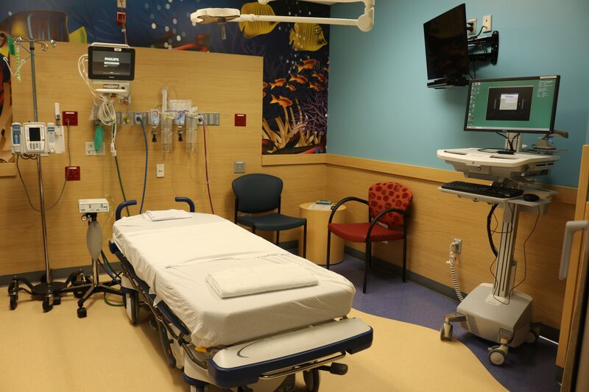
Next we will go into the Sedation room.

Slide 13
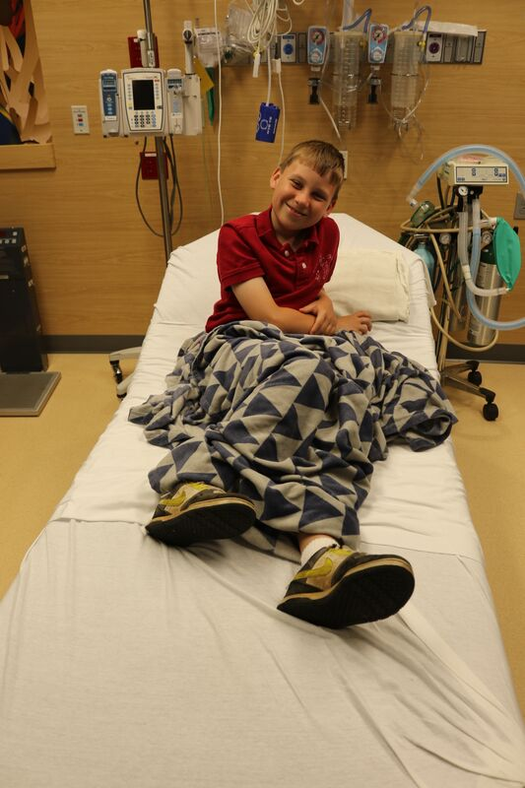
I will sit on the bed or lie down if I like.
The bed will be soft and comfortable!

Slide 14
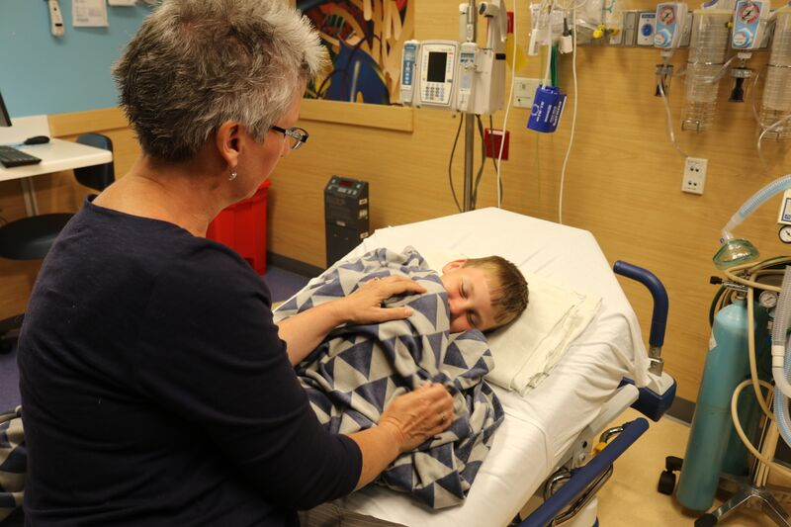
My Mom will be right next to me the whole time!
I can watch TV or play on an iPad if I want.

Slide 15
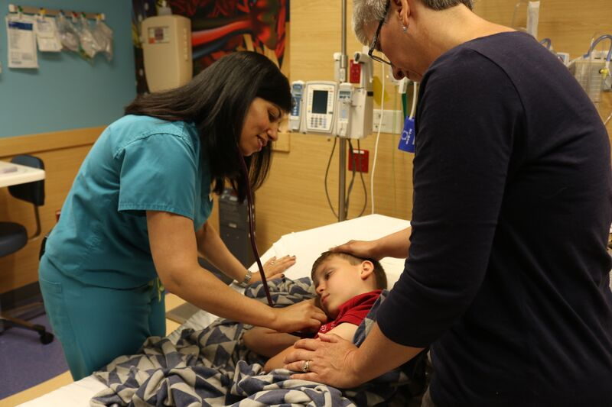
The nurse will talk to us.
Then she will listen to my chest with a stethoscope.

Slide 16
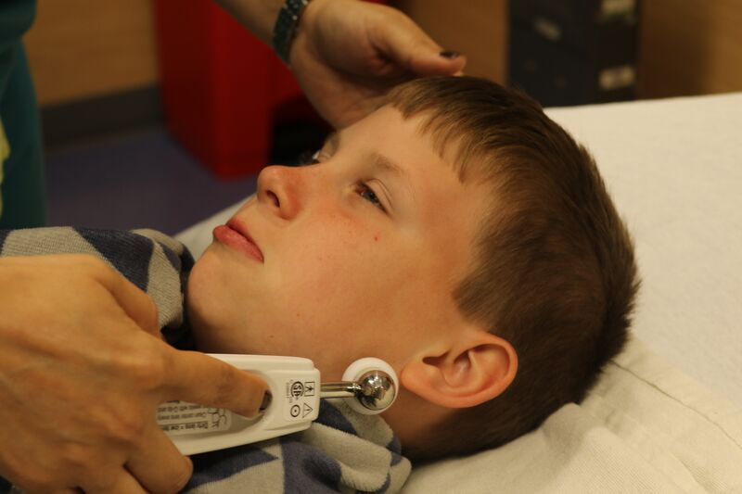
She will take my temperature

Slide 17
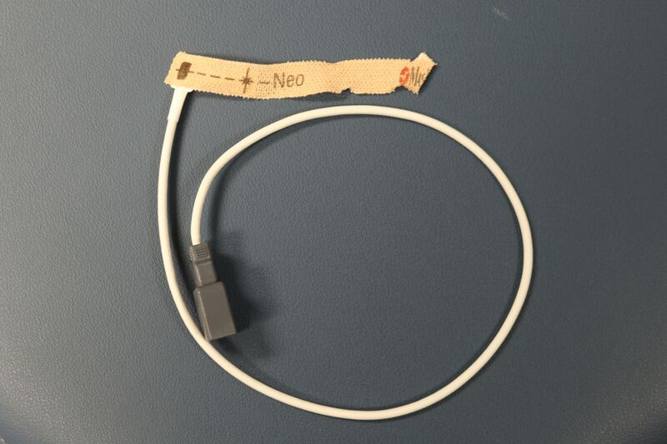
She will put a sticker with a red light on my finger.
This will not hurt.

Slide 18
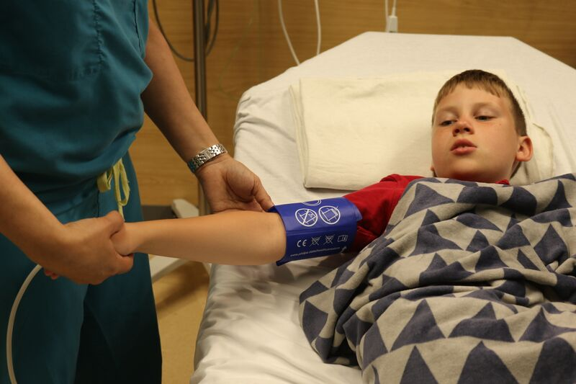
She will check my blood pressure by putting a cuff on my arm.
It will feel like a tight hug, but it won’t hurt.
The nurse does all this to keep me safe. I need to be still and keep my hands on my own body. Everyone will be happy if I follow directions.

Slide 19
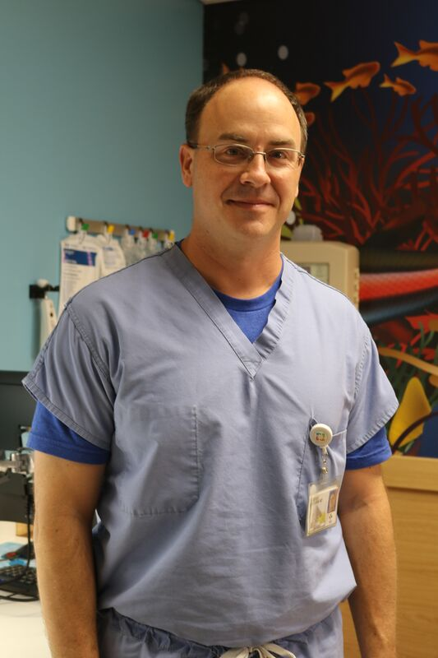
A doctor will come to speak to us.
The doctor will listen to my chest with a stethoscope and look into my mouth with a light.
This will not hurt.

Slide 20
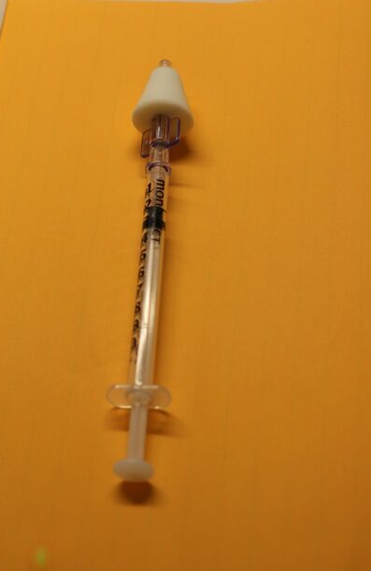
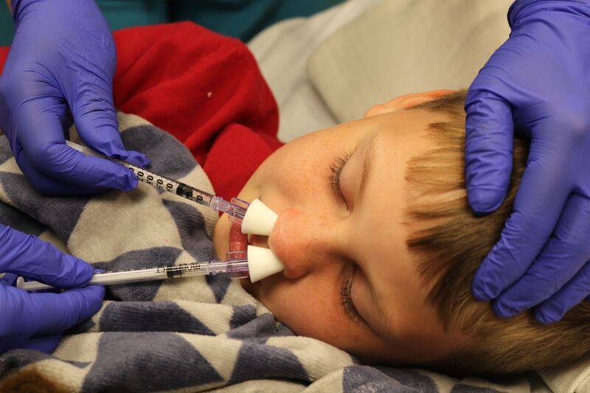
The nurse may use a syringe with a soft, white tip to put some medicine in my nose.
This will not hurt. It is okay to spit if I don’t like how it tastes

Slide 21
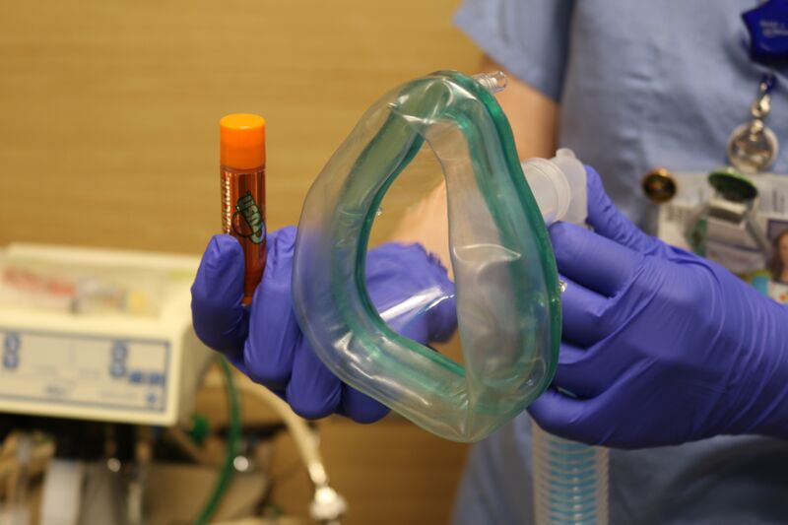
The doctor may give me a mask with medicine in it.
I can choose a special smell if I want.

Slide 22
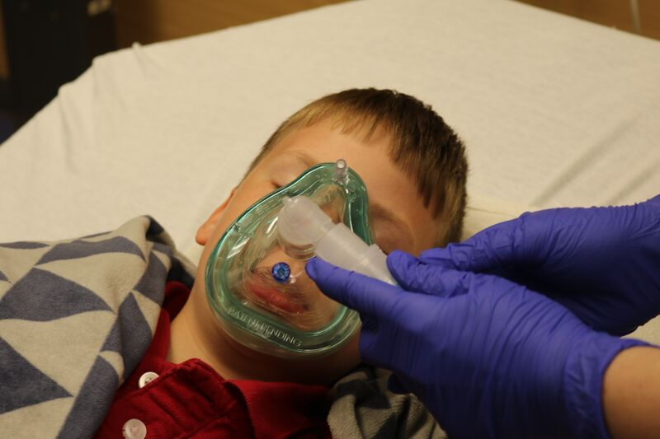
The mask will feel soft on my face.
And it will smell good!
When I breathe in the medicine, I will feel relaxed.

Slide 23
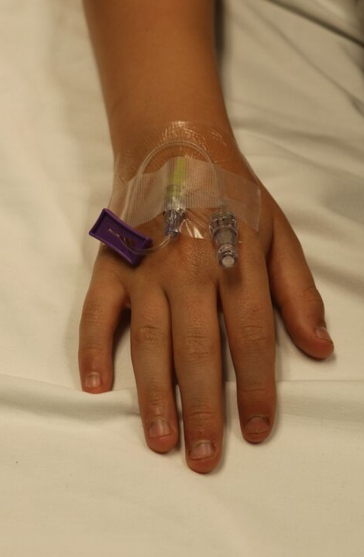
The nurse may put an IV in my arm. It will feel like a quick pinch. She will use special tape to keep the IV in place.
The doctor needs the IV to give me sleeping medicine.

Slide 24
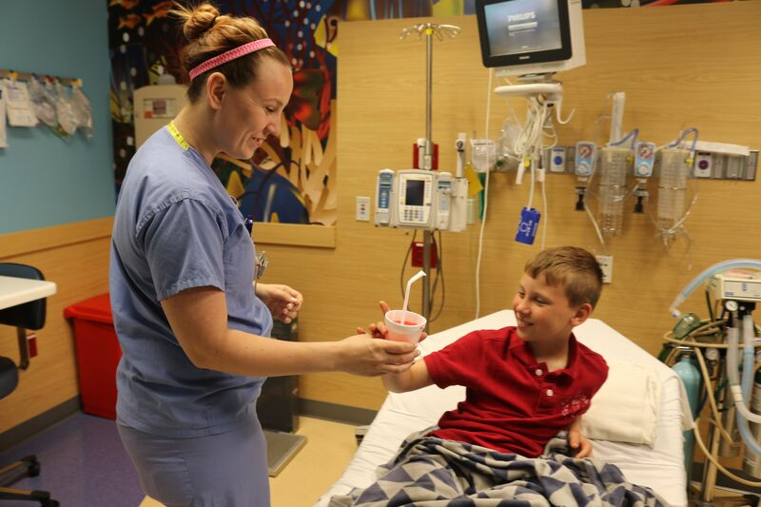
When my special test is over, I will wake up. I may feel sleepy or tired. This is okay.
When I am ready I will drink some juice, or I can get a slushy if I want one. It tastes great!

Slide 25
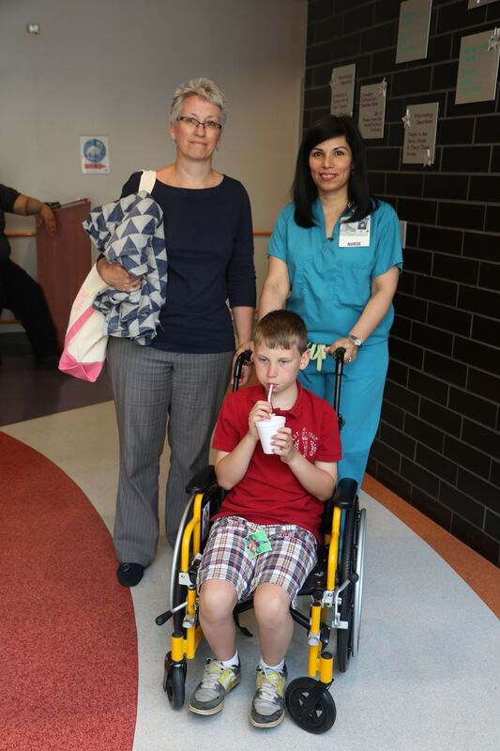
Now it is time to go home. Everyone is happy that I did such a great job in Sedation!
Going to Sedation is not so hard. I know just what to do!

Slide 26

The Sedation Social Story was developed by
Dr. Kalyani Raghavan, MBBS, MD, DCH, FAAP and Jennifer Twachtman-Bassett, MS, CCC-SLP with a grant from Autism Speaks.

